Slide 1
Digital Marketing

Slide 2
Difference b/w Traditional Marketing and Digital Marketing
Traditional Marketing |  | Digital Marketing
Limited Reach Expensive Delayed Communication Poor Campaign Measurement Difficult to reach target audience |  | Maximum Reach Cost-efficient Instant Communication Easy Campaign Measurement Easy to reach target audience

Slide 3
Defining Digital Goals
Importance of Digital Goals
Aligning Digital Goals with Business Objectives
Types of Digital Goals

Slide 4
Business Goals Alignment
Aligning Digital Presence with Business Objectives
Examples of Alignment:
Increase Sales → Boost Website Traffic
Brand Awareness → Social Media Engagement
Customer Support → Chatbot Integration

Slide 5
Short-Term vs Long-Term Goals
Short-Term Goals:
Social Media Account Setup
Initial Website Launch
Email List Creation
Long-Term Goals:
Brand Awareness
SEO Improvements
Customer Loyalty Programs

Slide 6
SMART Goals
Specific: Clear and well-defined objectives
Measurable: Quantifiable targets
Achievable: Realistic and attainable
Relevant: Aligned with business strategy
Time-Bound: Defined deadlines
Example: Increase website traffic by 20% within 3 months.

Slide 7
Identifying Target Audience
Importance of Understanding Your Audience
Market Segmentation
Audience Persona Development
Customer Needs Analysis

Slide 8
Market Segmentation
Dividing the Market by:
Demographics
Psychographics
Behavioral Patterns
Geographics

Slide 9
Audience Persona Development
Creating Fictional Profiles
Example Persona:
Name: Sara Khan
Age: 30
Interests: Online Shopping, Social Media
Pain Points: Difficult Customer Support

Slide 10
Understanding Customer Needs
Surveys and Feedback Collection
Social Media Listening
Website Analytics

Slide 11
Competitor Analysis
Why Analyze Competitors?
Tools for Competitor Research
SWOT Analysis

Slide 12
Tools for Competitor Research
SEMrush (SEO & Traffic Analysis)
Google Alerts (Mentions & Updates)
SimilarWeb (Website Traffic Insights)
Social Media Monitoring Tools

Slide 13
SWOT Analysis
Strengths: What competitors do well
Weaknesses: Areas they lack in
Opportunities: Gaps in the Market
Threats: External Factors

Slide 14
Crafting a Digital Roadmap
Importance of a Digital Roadmap
Key Steps to Develop Roadmap
Budget Allocation

Slide 15
Step-by-Step Strategy Development
Define Digital Channels (Website, Social Media, Email Marketing)
Content Strategy Development
Timeline for Execution

Slide 16
Defining Milestones
Set Achievable Milestones:
Website Launch Date
First 1000 Followers on Social Media
Monthly Blog Publishing Schedule

Slide 17
Budget Allocation
Prioritizing Digital Channels
Cost Estimation for:
Website Development
Social Media Ads
Content Creation

Slide 18
Meta Tags
Title Tags
Meta Descriptions
Importance of Keywords in Meta Tags

Slide 19
Page Speed Optimization
Why Page Speed Matters
Tools to Test Page Speed (Google PageSpeed Insights)
Tips to Improve Page Speed

Slide 20
Mobile Responsiveness
Importance of Mobile-Friendly Websites
Google’s Mobile-First Indexing
Tools for Testing Mobile Responsiveness

Slide 21
Website Security Basics
SSL Certificates
Regular Backups
Plugins for Security

Slide 22
Website Maintenance & Updates
Importance of Regular Updates
Content Refreshing
Security Patches

Slide 23
Tools for Website Management
Google Analytics
Google Search Console
Yoast SEO Plugin (WordPress)

Slide 24
Search Engine Optimization (SEO)

Slide 25
Basic SEO Setup for Websites
What is SEO?
Why SEO Matters for Business Websites
On-Page SEO Basics

Slide 26
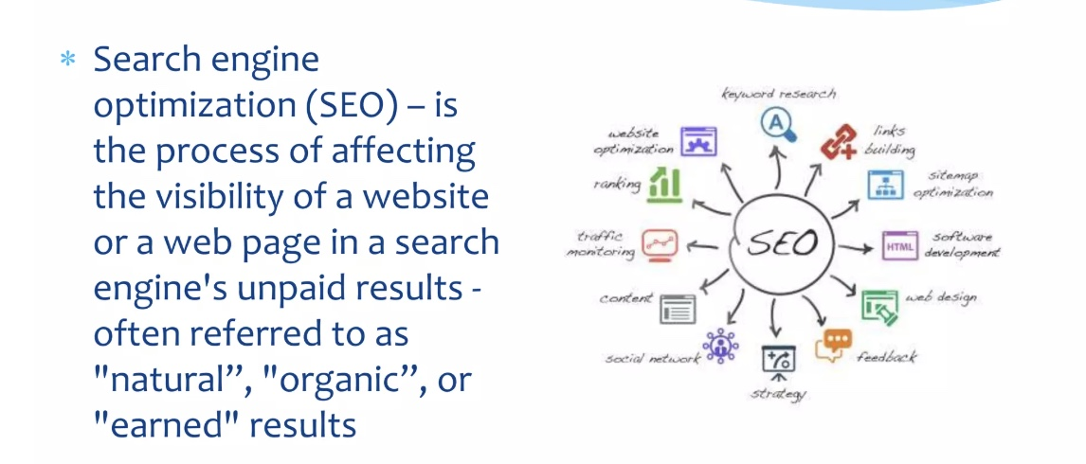
What is SEO

Slide 27
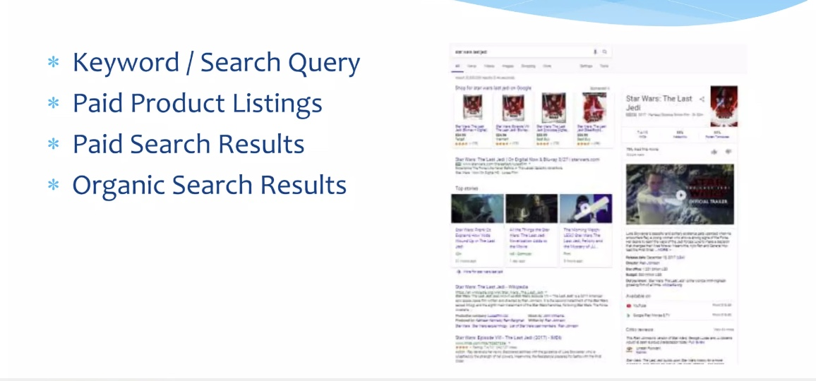
Structure of a SERP (Search Engine Result Page)

Slide 28
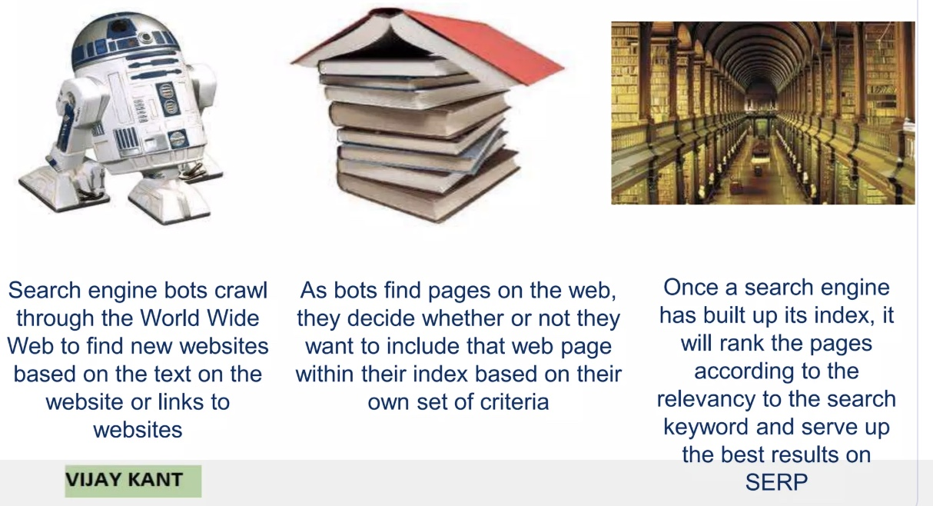
1.) Crawl Links and Websites
3.) Apply Ranking Algorithm
2.) Index and Cache Web Pages

Slide 29
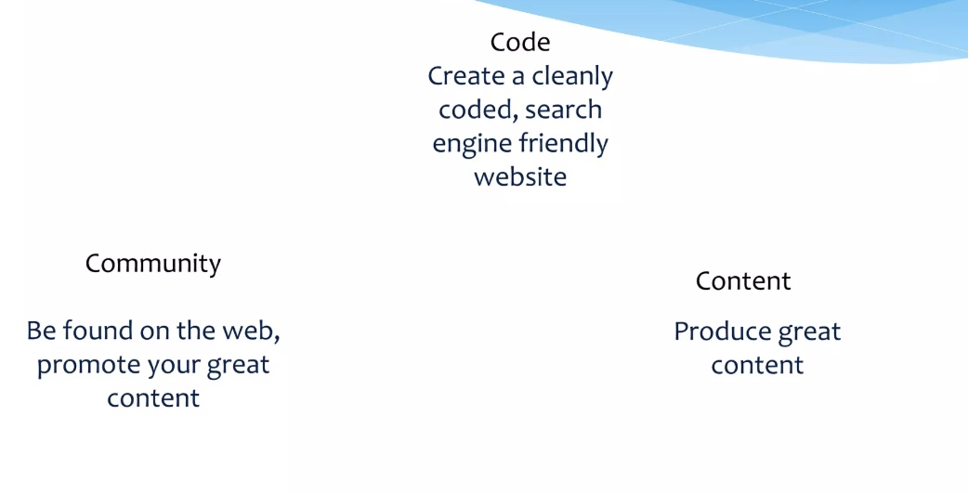
3 Keys to Higher Search Engine Rankings

Slide 30
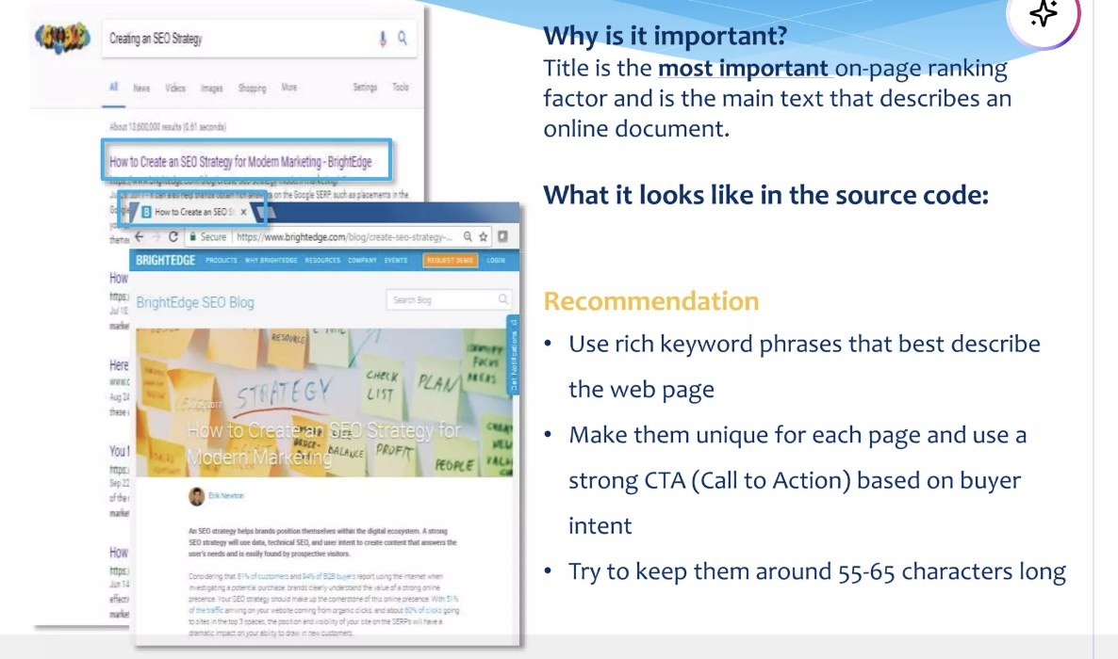
Title Tags

Slide 31
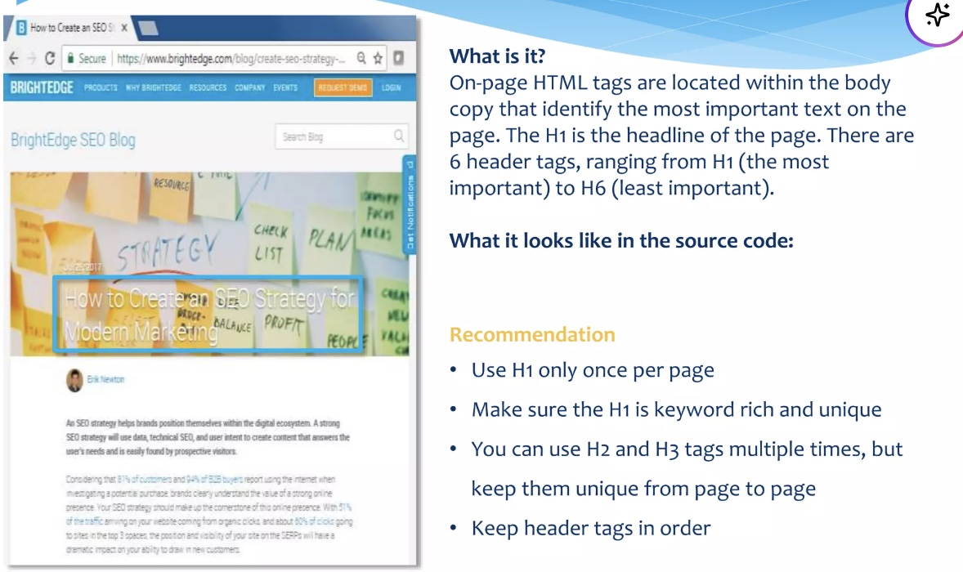
Tags

Slide 32
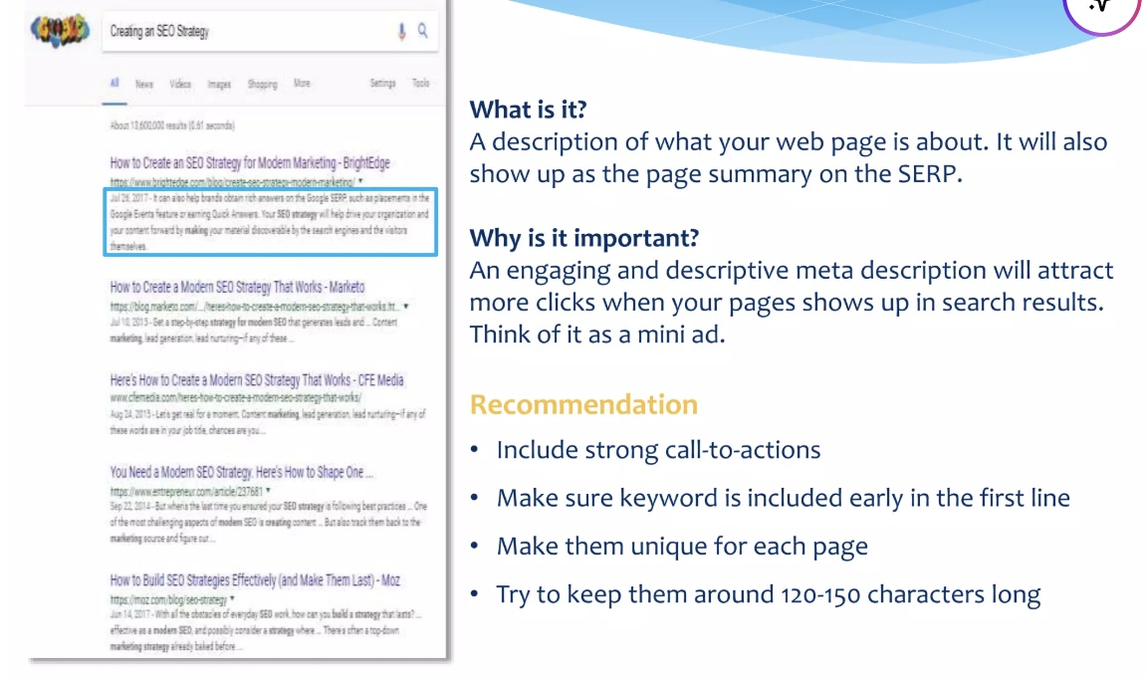
Meta Description

Slide 33
End of Lecture

